Slide 1
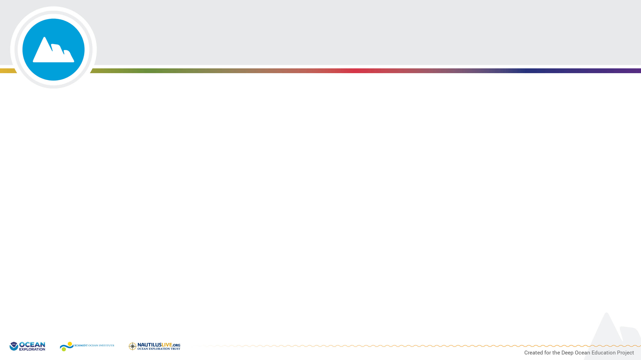
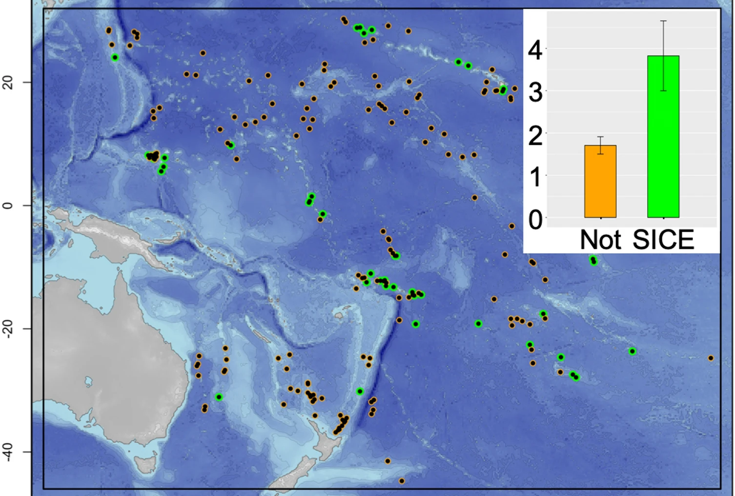
Seamount-Induced Chlorophyll Enhancements (SICE) based on analysis of satellite data.
Japan
Inset graph shows mean historical total fisheries catch in tens of thousands of metric tons (y-axis) around seamounts not associated with and associated with enhanced chlorophyll concentrations (x-axis).
SICE = Seamount- Induced Chlorophyll Enhancements
Hawaiian Islands
Key
Seamount associated with enhanced chlorophyll concentrations
Seamount not associated with enhanced chlorophyll concentrations
American Samoa
Latitude
Australia
New Zealand
360° East Longitude
Adapted from: https://www.nature.com/articles/s41598-020-69564-0/figures/1
Notes:
Adapted from: https://www.nature.com/articles/s41598-020-69564-0/figures/1

Slide 2
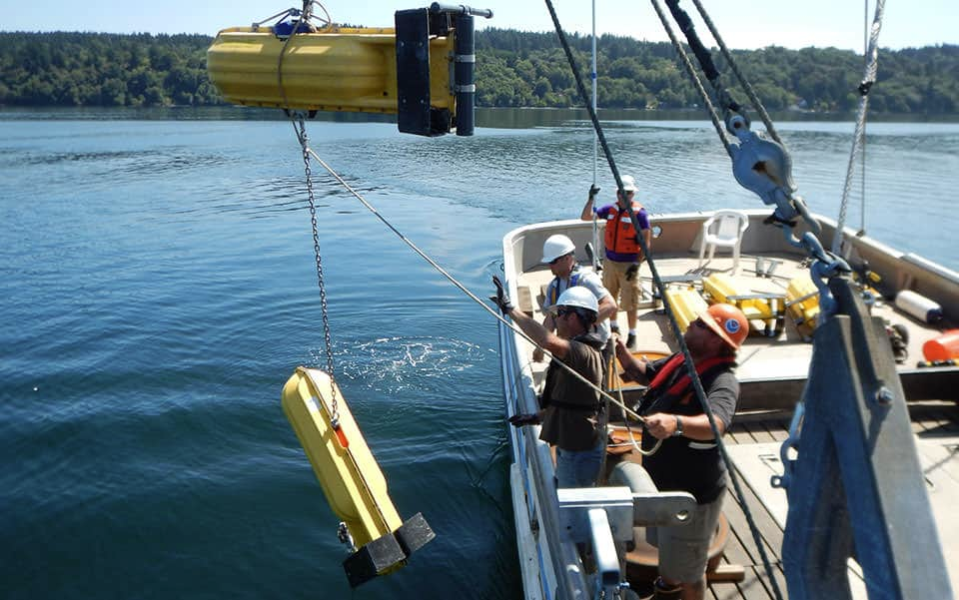
Measuring Currents
Current meters attached to cable anchored to bottom at one end and suspended by a buoy at other end taking measurements of currents.
Several meters were located at various depths along each cable so water motion could be studied at intervals throughout water column.
Each cable with its attached current meters is called an array.
Each current meter is capable of recording water movement in 3 directions, similar to x, y, and z- axis of a 3D graph.
Link: https://oceanservice.noaa.gov/podcast/july17/nop09-current-surveys.html

Slide 3
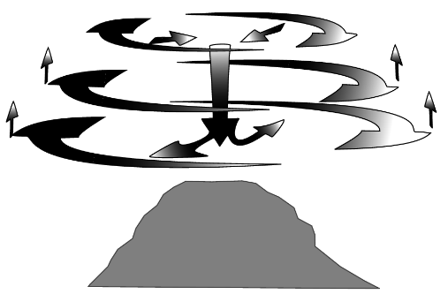
3-D Diagram of Mean Flows in Fieberling Guyot Circulation Cell
Redrawn from Mullineaux and Mills, 1997

Slide 4
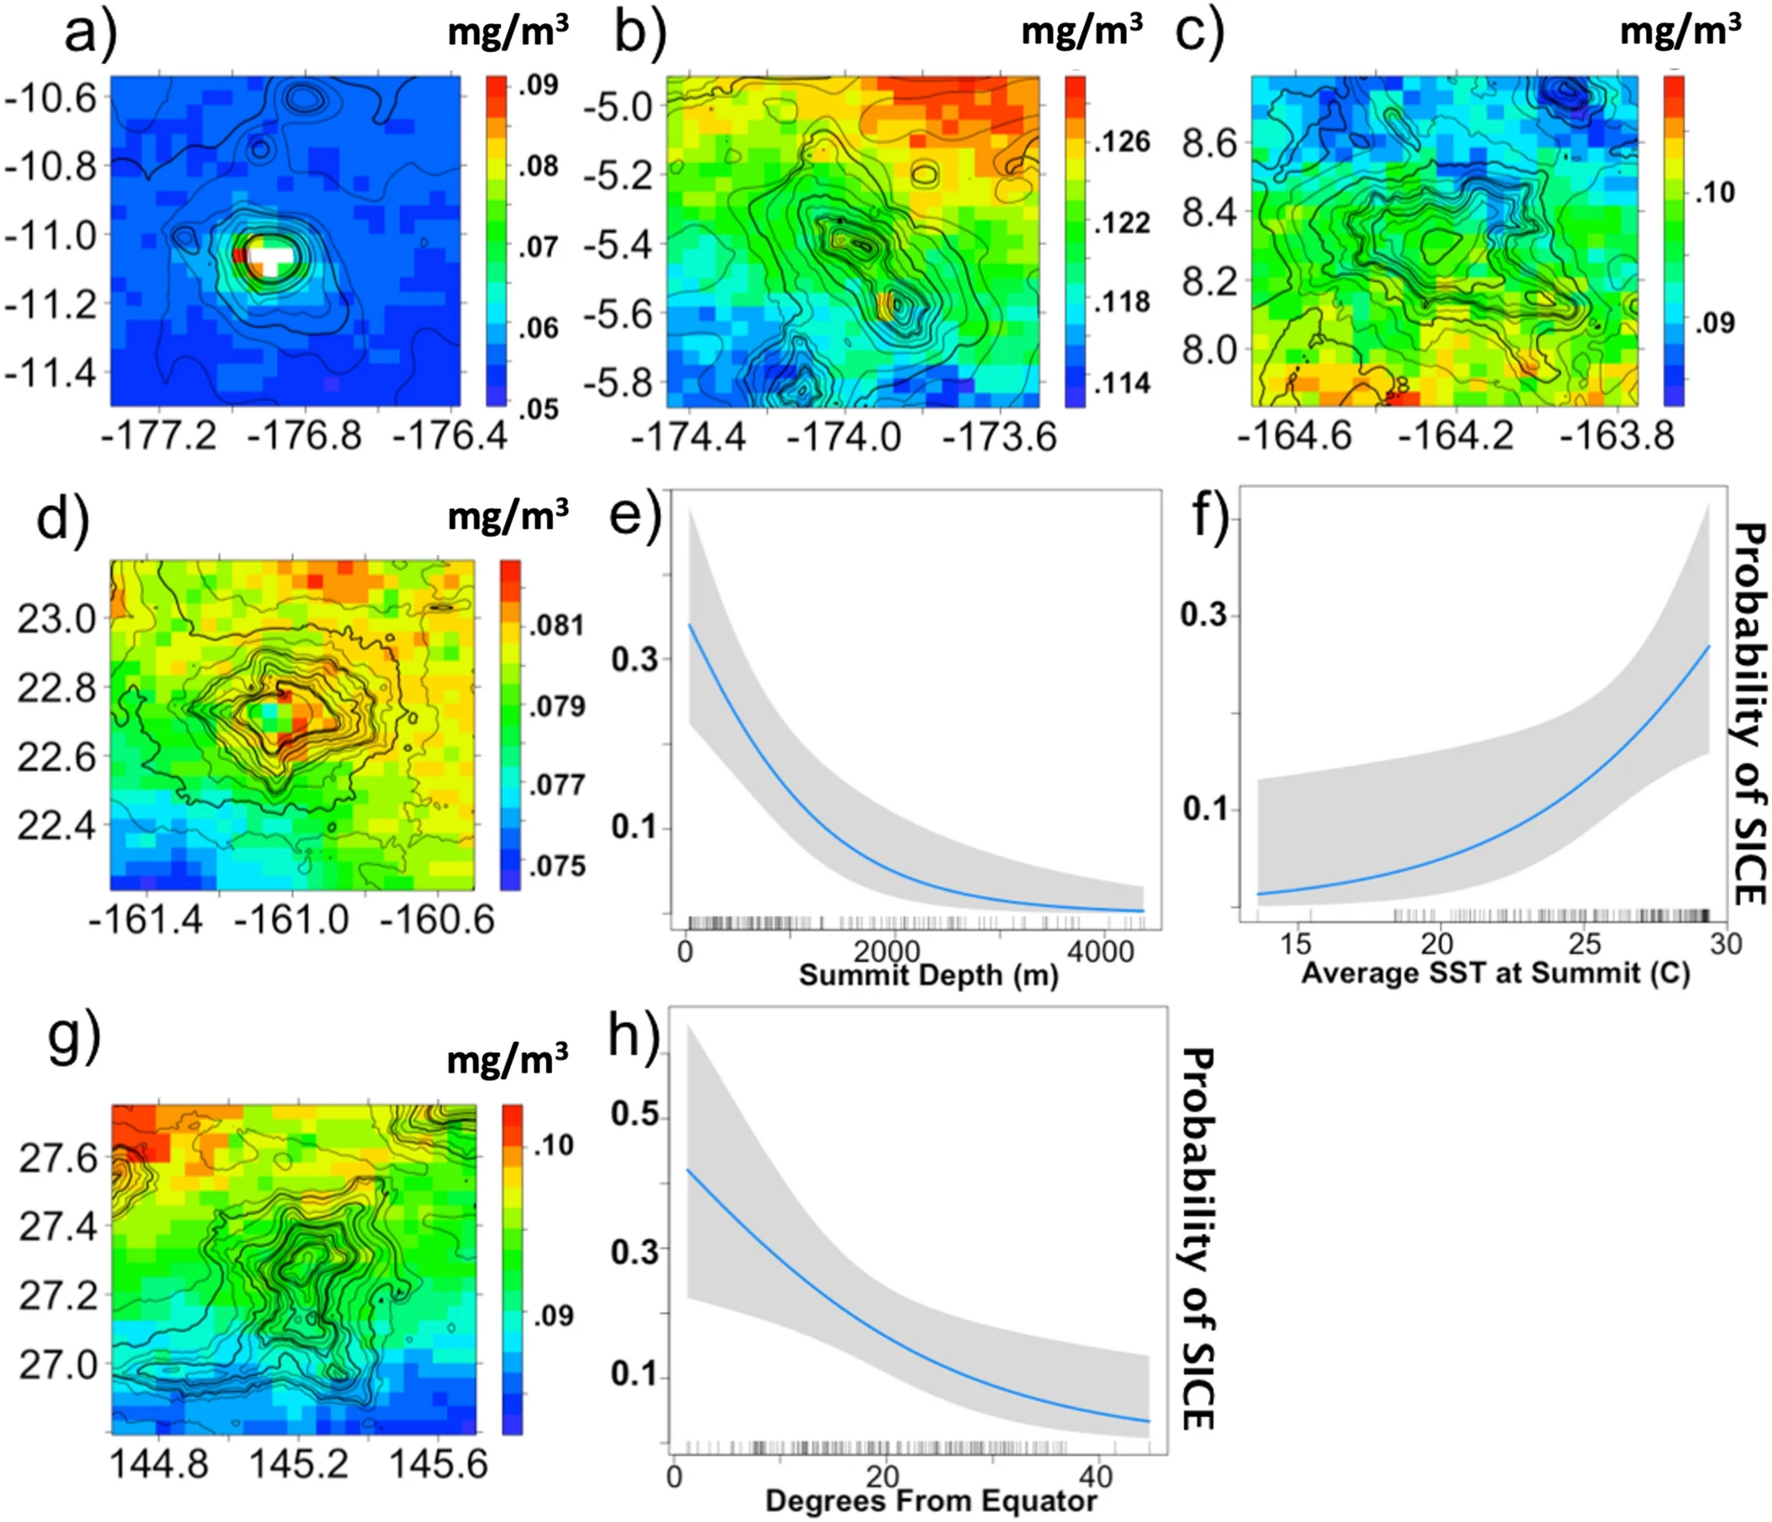
Biophysical Drivers of Seamount-Induced Chlorophyll Enhancements (SICE)
A
B
C
Figures A, B, and C show the plots of the modeled probability of SICE with three different geophysical predictors: (A) summit depth, (B) average Sea Surface Temperature (SST), and (C) degrees from equator, all significant predictors of SICE.
Adapted from: https://www.nature.com/articles/s41598-020-69564-0/figures/2

