Slide 1
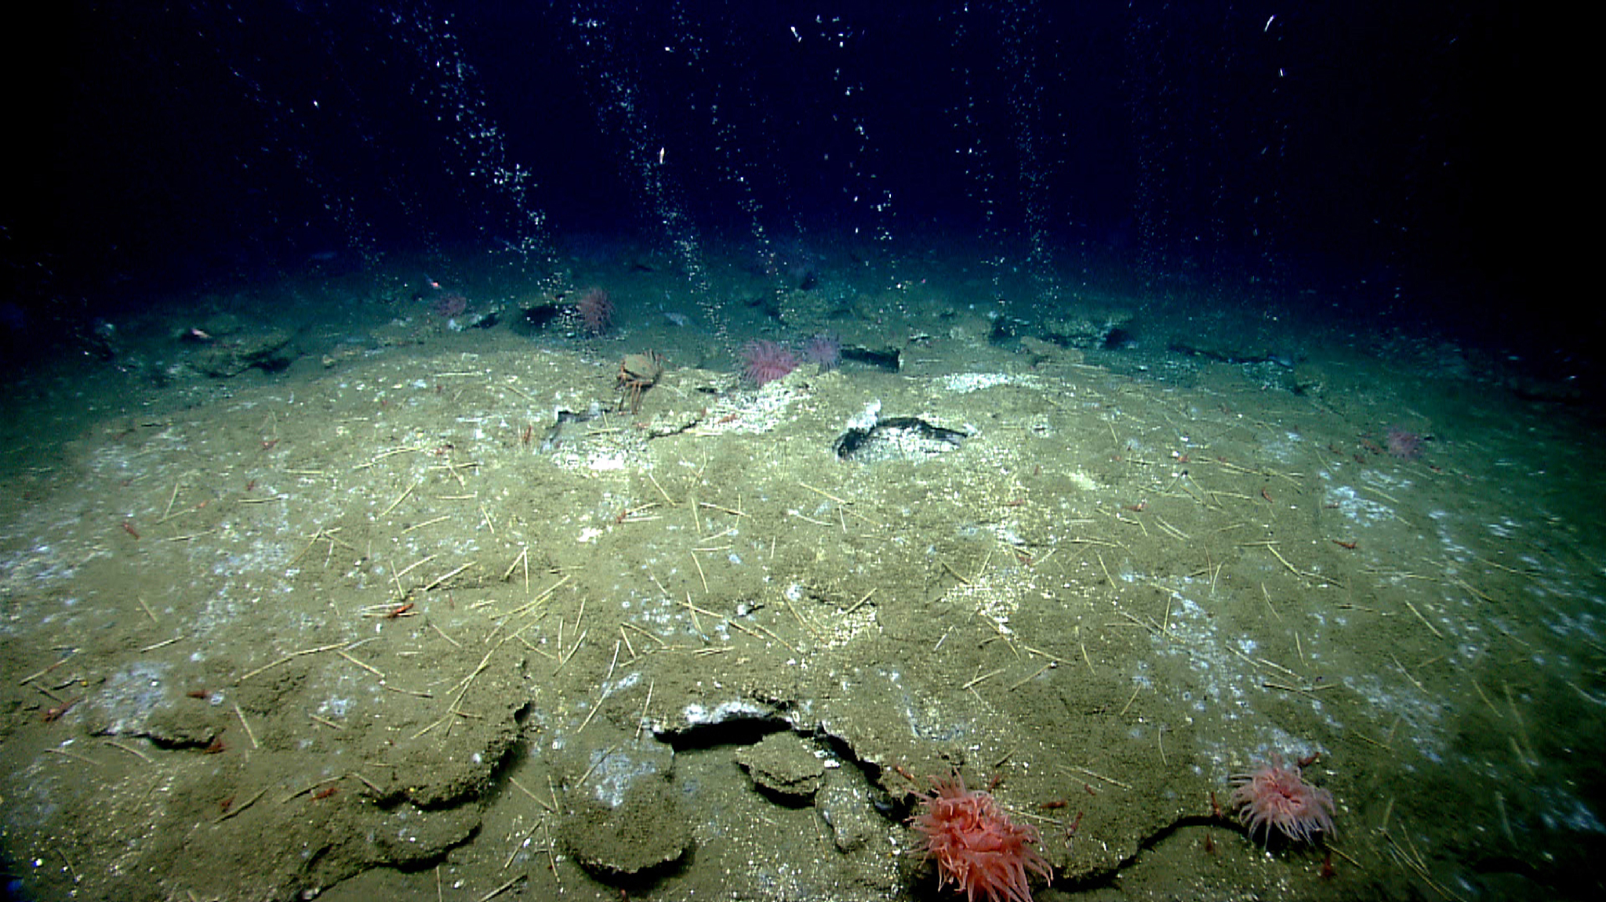
Background: Cold Seeps
Cold Seeps
  places where hydrogen sulfide, methane, and other hydrocarbon-rich fluids and/or gases escape from cracks in the ocean floor
Methane Cold Seep
  characterized by methane and hydrogen sulfide bubbles coming out of the seafloor
  chemicals provide energy for chemosynthetic ecosystems
Image courtesy of NOAA Ocean Exploration.
https://oceanexplorer.noaa.gov/okeanos/explorations/ex1903/background/seeps/welcome.html

Slide 2
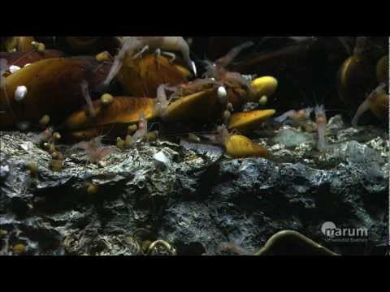
Experience the Phenomenon: Cold Seeps and Methane Hydrates
Source: https://www.youtube.com/watch?v=ahmjHLyF9GM

Slide 3
Think about it!
Have you ever seen an unfamiliar insect or other animal?
Did you wonder where it lived, what it ate, or how it survived day to day?
Scientists think about those same things when they come across new animals.

Slide 4
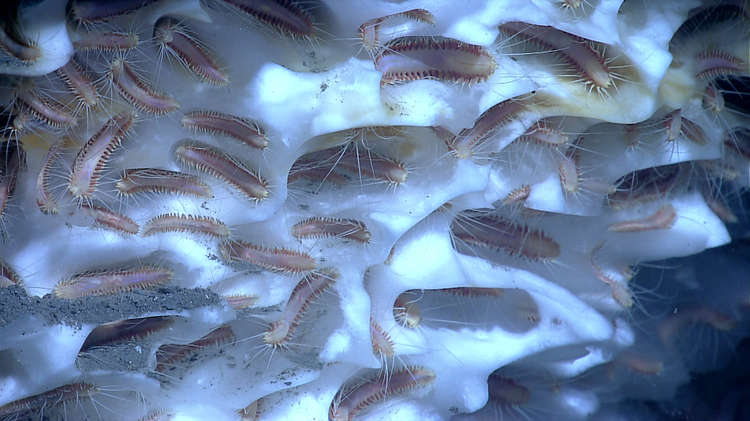

Slide 5
Methane Ice Worms of the Gulf: Optional
In July 1997, eyeless worms were found living on methane ice >500m deep in the Gulf of Mexico.
  New organism AND a new niche, or a new ecosystem role
Scientists had never seen an organism living on methane hydrate.
  composed of methane gas locked into a water ice crystal structure
  also may include significant amounts of hydrogen sulfide and oils
Adult worms
  2 to 4 cm long, single adult worm in each depression
  density of worms on hydrate surface ~2,500 individuals/square meter
  related to earthworms - bristles protruding from appendages on each body segment
Methane ice worms were the only organism visible on the hydrates, with no apparent predators or prey.
Big question:
How do methane ice worms obtain organic compounds and energy while living on methane hydrate?

Slide 6
Investigate: Think about it!
What is the original source of energy for most food chains on Earth?
Why can scientists not assume this to be the case for the methane ice worms?
What are possible ways methane ice worms could obtain energy and organic compounds from the methane hydrate?

Slide 7
Investigate: Methane Ice Worm Hypotheses
Methane
1) The worms metabolize methane directly.
2) The worms consume bacteria that metabolize methane.
3) The worms rely on symbiotic bacteria that metabolize methane.
2 potential sources of energy
Hydrogen sulfide
4) The worms metabolize hydrogen sulfide directly.
5) The worms consume bacteria that metabolize hydrogen sulfide.
6) The worms rely on symbiotic bacteria that metabolize hydrogen sulfide.
3 potential ways ice worms can obtain organic compounds and energy

Slide 8
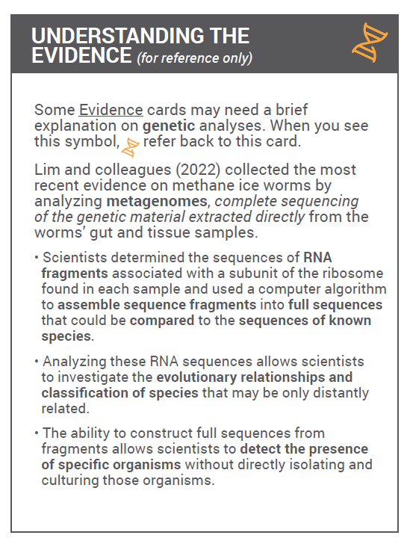
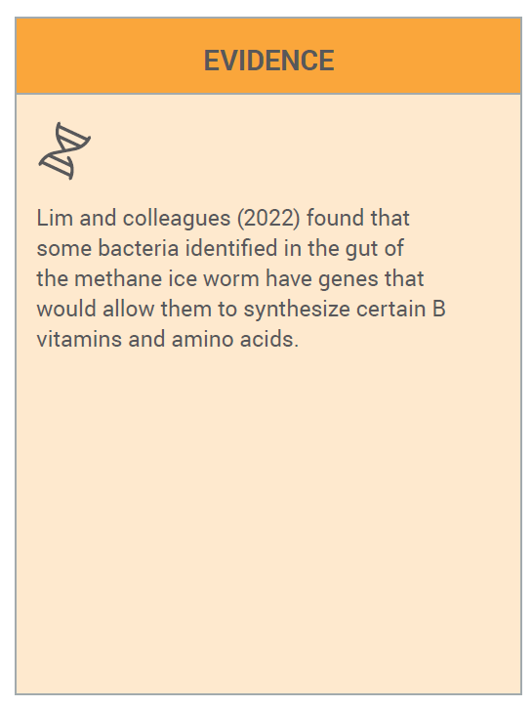
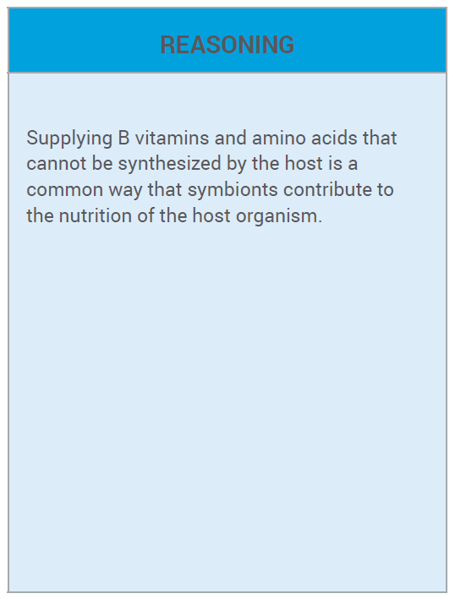
Investigate: Card Sort - Sample Match Below
2 Cards
15 Cards
15 Cards
Sort/Match Select Best Evidence and Reasoning Determine Best Hypothesis

Slide 9
Put the Pieces Together: Reflection
Are there any hypotheses that can be eliminated based on the class consensus?
Did your group come to a consensus regarding any remaining hypotheses?
Which pieces of evidence seem to be most important? Is there consensus within your group about this?
What changes would you make to your initial argument after seeing the arguments from other group members?
**Make sure your argument directly answers the question,
“How do methane ice worms obtain their energy and nutrients?”

Slide 10


Assessment: Final Written Argument
Be sure to include the following:
  The hypothesis your group selected.
  The specific evidence and reasoning selected.
  Rationale explaining how the selected evidence and reasoning supports your selected hypothesis.

